Slide 1

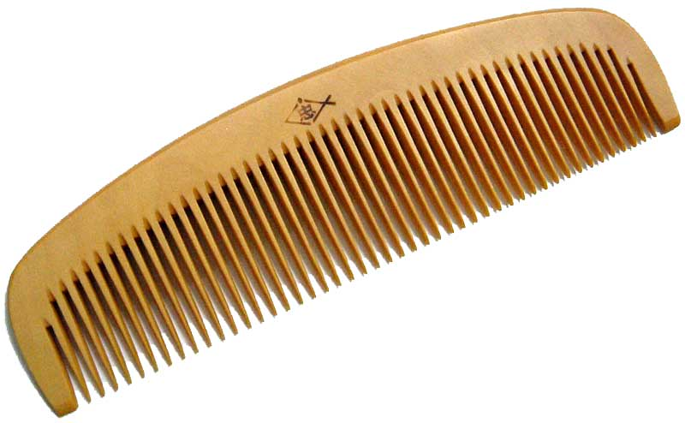
Comb sort
By: Jackie Xu

Slide 2
History
Bubble Sort
(1950s)
Although simple…
Comb Sort
(1980)
It was very slow…
Originally designed by
Włodzimierz Dobosiewicz
Later re-discovered and optimized by
Stephen Lacey and
Richard Box
More
Optimizations
(1991)

Slide 3

General Information
Method of sorting: Exchanging
9
Variation from
Bubble sort
Behaves like Bubble sort near the end
2

Slide 4
Time complexity
Efficiency
Best Case: O(n) (List already sorted)
Worst Case: O(n²)
Average Case: O(n log n)

Slide 5

Pros
Easy to code!
(Uses simple structures)
If statements
While loops
Arrays/lists

Slide 6
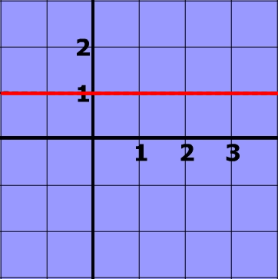
Pros
Memory efficient!
O(1)
(It does not need to create new arrays/lists)

Slide 7

Pros
Faster than bubble sort!
Why?
It brings the “turtles” (small numbers at the back of the list) forward quickly
Makes less passes and swaps

Slide 8
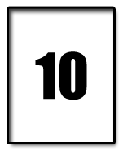
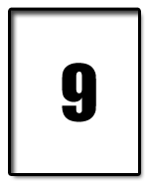
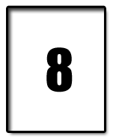
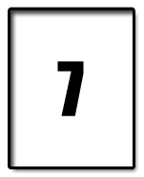


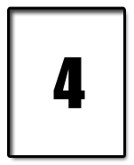
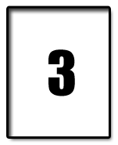
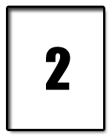
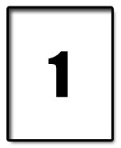
Example – Sorting numbers from 1 – 10 with bubble
After 1st pass: (9 questions, 9 swaps)
After 2nd pass: (9 questions, 8 swaps)
After 3rd pass: (9 questions, 8 swaps)

Slide 9
Example – Sorting numbers from 1 - 10
Bubble sort
Number of decisions: 9 × 9 = 81
Number of swaps: 9 + 8 +… + 2 + 1 = 45

Slide 10
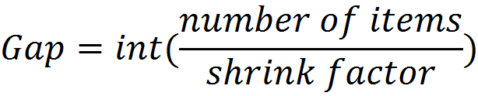
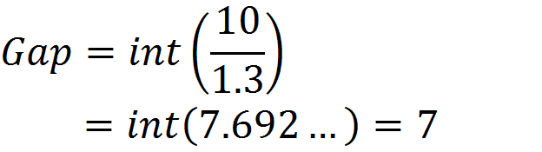
Initial Gap value – Comb sort
Eg. number of terms= 10
shrink factor = 1.3

Slide 11
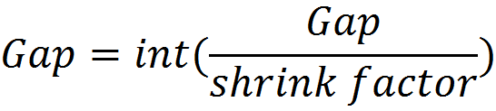
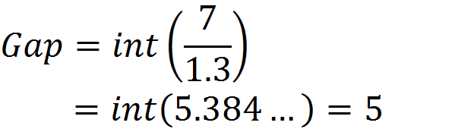
Following Gap values – Comb sort
Eg. previous Gap = 7
shrink factor = 1.3

Slide 12
Example – Sorting numbers from 1 - 10
Comb Sort
Number of decisions: 3 + 5 + 7 + 8 + 9 + 9 = 41
Number of swaps: 3 + 0 + 1 + 2 + 1 + 0 =7

Slide 13
Example – Sorting numbers from 1 – 10 with Comb

Slide 14
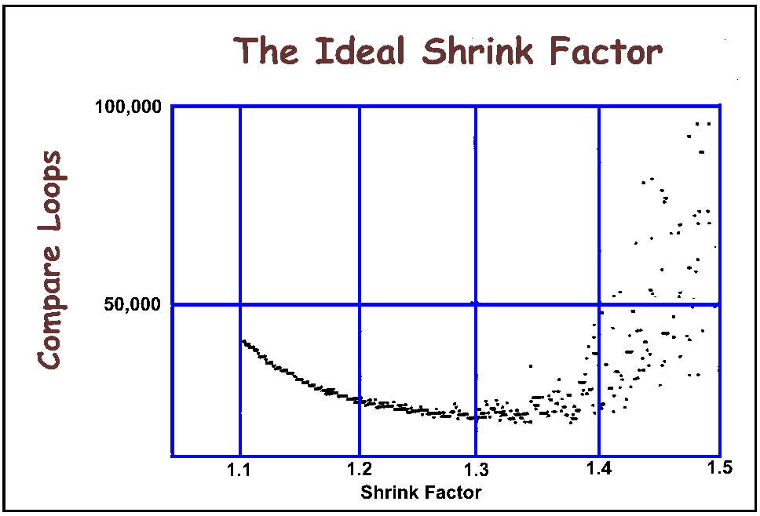
Shrink factor: Why 1.3?
Answer: Optimizations done by its inventors (over 200,000 random test sorts)

Slide 15

Cons
What’s its flaw?
It’s an Unstable Sort

Slide 16
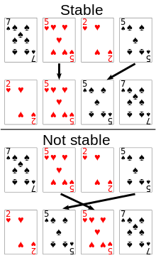
Stable vs. Unstable sorts
Suits properly sorted
Suits NOT properly sorted

Slide 17
Pseudocode
// Comb sort
shrink = 1.3 // shrink factor (usually 1.3)
gap = input.size
while (gap != 1 or swapped == true) // terminates when list is sorted
gap = int (gap / shrink)
if (gap < 1)
gap = 1 // The sorts behaves like bubble sort after this
swapped = false // initializes condition variable
i = 0
while (i + gap < input.size) // loop that sets boundaries
if (input [i] > input [i + gap]) // swapping algorithm
swap (input [i], input [i + gap])
swapped = true
i++

Slide 18

So why/when to use it?
Simple to write! – Any average programmer can do it!
Efficient! – On average more efficient than Bubble, selection and insertion sort
Great for sorting lists/arrays of integers, floats characters, and other primitive variables

Slide 19

So when do you NOT use it?
Sorting elements with more than one attributes – Eg, cards with multiple suits (Since it’s an unstable sort)
Avoid using when sorting advanced OBJECTS!!!
(Here’s where Bubble sort surpasses it, it’s stable!!!)

Slide 20


Slide 21
References
http://code.wikia.com/wiki/Comb_sort
https://en.wikipedia.org/wiki/Comb_sort
https://en.wikipedia.org/wiki/Sorting_algorithm
http://rosettacode.org/wiki/Sorting_algorithms/Comb_sort
https://xlinux.nist.gov/dads//HTML/combSort.html
https://www.youtube.com/watch?v=ob49RukGnAw
https://www.youtube.com/watch?v=s1CQUo_rTm8

